Slide 1

Management Approaches
Comprehensive Frameworks: From Classical Schools to Modern Strategic Planning Models

Slide 2

Meaning & Definition
What is it?
A management approach is a systematic framework and philosophy used to understand, analyze, and solve complex organizational challenges.
Why does it matter?
It provides the necessary theoretical grounding and practical methodologies for planning, organizing, leading, and controlling resources efficiently to achieve predefined objectives.

Slide 3






Significance of Management Approaches
Efficiency & Output
Strategic Adaptability
Goal Realization
Facilitates the optimal utilization of organizational resources, capital, and labor to minimize systemic waste and maximize operational productivity.
Aligns fragmented individual and departmental efforts into cohesive workflows, ensuring all actions drive toward overarching corporate objectives.
Provides agile, scalable frameworks that allow organizations to proactively navigate and respond to rapidly shifting market dynamics and external pressures.

Slide 4
Schools of Management Thought
The evolution from task-centric optimization to environment-centric adaptation.

Slide 5


Early Frameworks
Classical Approach
Behavioural Approach
Focuses intensely on organizational structure, systematic efficiency, and scientific methodologies (e.g., Taylor, Fayol).
Emerged as a direct response to the rigidity of classical theories. Emphasizes human relations, organizational psychology, and social dynamics.
It fundamentally treats workers as economic entities who are driven primarily by financial incentives, strict supervision, and clear operational hierarchies.
Views workers as complex, psychologically driven social beings who require motivation, empathy, and positive interpersonal relationships to succeed.

Slide 6


Modern Paradigms
■
The System Approach views the organization as an interconnected entity of interrelated sub-systems working toward a common goal.
■
Because of this interconnectedness, changes in one department or workflow inherently impact the entire organizational ecosystem.
■
The Contingency Approach argues that there is no absolute "one best way" to manage, lead, or organize.
■
Managerial actions must adapt dynamically, depending strictly on external environmental variables and internal situational factors.

Slide 7
Types of Management Approaches
Strategic Planning Models: Evaluating Manpower, Costs, and Societal Impact.

Slide 8
Quantitative vs. Qualitative Demand
Man Power Approach
Social Demand Approach
Forecasts the future economic needs for specific, specialized skills within a target industry or national economy.
Plans institutional resources based on the projected aggregate demand and aspirations of the general population.
Strategic planning and educational output are directly aligned to meet market labor demands, aiming to prevent structural skill shortages and drive GDP growth.
Prioritizes widespread access, societal well-being, and individual choice over strict economic utility or corporate labor requirements.

Slide 9






Financial & Equitable Models
Cost-Benefit
Rate of Return
Social Justice
Evaluates organizational decisions by strictly weighing the financial expenditures against expected monetary benefits to assess viability.
Calculates the internal yield on capital investments over time, treating human resources and training as an investment portfolio.
Focuses on systemic equity, ensuring that management policies and resource distribution proactively rectify historical disparities.

Slide 10

Comparative Analysis Matrix
Planning Approach | Primary Focus | Key Metric | Ultimate Goal
Man Power | Labor Needs | Economic Output | Fill Market Skill Gaps
Social Demand | Public Desire | Access Rates | Widespread Education/Service
Cost-Benefit | ROI | Cost vs. Gain Ratio | Financial Efficiency
Rate of Return | Yield Percentage | Investment Value | Maximize Capital Return
Social Justice | Equity | Distribution Fairness | Societal Balance

Slide 11
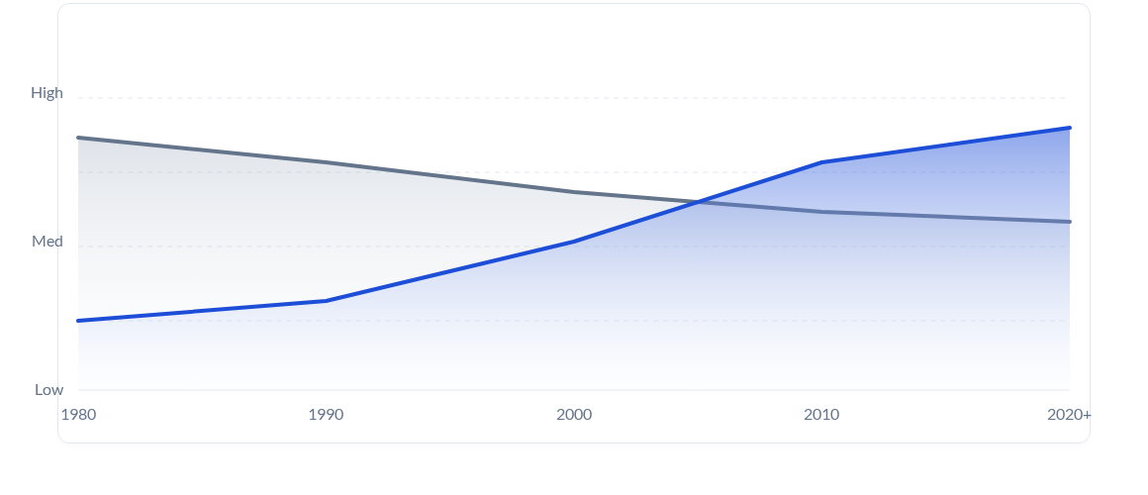
Evolution of Strategic Focus
Strict Economic / Manpower Focus
Social Impact & Contingency Focus

Slide 12
Questions & Discussion
Thank you for your attention.
strategy@managementinstitute.com | www.managementinstitute.com

Slide 13


Image Sources
https://png.pngtree.com/thumb_back/fh260/background/20260114/pngtree-luxury-corporate-meeting-room-with-cityscape-view-at-sunset-modern-office-image_21114421.webp
Source: pngtree.com
https://png.pngtree.com/thumb_back/fw800/background/20260323/pngtree-vibrant-network-visualization-with-interconnected-nodes-and-glowing-connections-image_21305311.webp
Source: pngtree.com

