Slide 1

CRITERIA OF GOOD TEST CONSTRUCTION
Criteria of Good Test
Exploring Validity, Reliability, Objectivity, and Norms in Assessment Construction
By Richa Kalita
Asstt Prof

Slide 2



Why Standardized Criteria?
A well-constructed test is essential for the fair and accurate measurement of human abilities, traits, or achievements. It requires rigorous, scientifically backed criteria to ensure the results are meaningful.
Minimizes Bias: Prevents subjective interpretation from skewing results.
Ensures Consistency: Allows tests to be administered across widely different populations reliably.
Drives Decisions: Provides highly actionable and defensible data for educational or clinical decision-making.

Slide 3











The Four Pillars of Testing
Validity
Reliability
Objectivity
Norms
Does the test actually measure the specific concept it claims to measure?
Does the test produce consistent, stable results over multiple administrations?
Is the scoring metric entirely free from the grader's personal biases?
Are there standardized reference points for properly interpreting the scores?

Slide 4
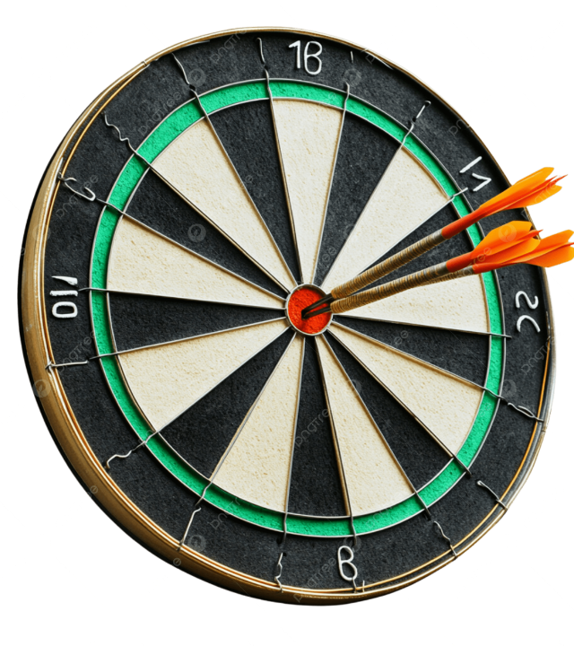
Understanding Validity
Validity is unanimously considered the most crucial criterion of test construction.
A test is structurally valid if and only if it measures the exact trait, construct, or skill it is designed to evaluate.
Without high validity, a test's results are essentially meaningless—no matter how mathematically consistent the scores might appear on paper. It represents accuracy in hitting the intended target.

Slide 5


Dimensions of Validity
Content Validity
Construct Validity
Evaluates how comprehensively a test covers the universe of items or situations it is supposed to represent.
Assesses whether a test successfully measures the underlying theoretical construct it is engineered to measure.
For example, a final math exam demonstrates high content validity if it includes proportional questions from every single topic taught during the semester, rather than focusing entirely on just one chapter.
Constructs are non-observable traits like intelligence, anxiety, or critical thinking. Establishing construct validity requires complex statistical analysis to ensure the test isn't measuring a related but distinct trait.

Slide 6

The Power of Reliability
Reliability refers strictly to the consistency, stability, and dependability of a test's scores.
If an individual takes the same test multiple times under identical conditions, a highly reliable test will yield roughly the same score every time.
High reliability indicates minimal random measurement error.
It is typically measured using correlation coefficients (ranging from 0 to 1).
Note: A test can be perfectly reliable without being valid.

Slide 7









Assessing Consistency
Test-Retest
Split-Half
Parallel Forms
Administering the exact same test twice to the same group after a time interval to measure stability.
Dividing a single test into two halves (e.g., odd and even questions) to check for internal consistency.
Administering two distinct, structurally equivalent versions of a test to the same group of test-takers.

Slide 8

The Crucial Relationship
Valid
Reliable
Must be Reliable
Might Not Be Valid
A valid test is always reliable because it accurately and consistently measures the target. However, a reliable test is not necessarily valid—it might consistently measure the wrong thing.

Slide 9

Eliminating Rater Bias
Objectivity implies that the scoring of the test is completely independent of the person grading it.
If two separate, independent evaluators score the same exam, they should arrive at the exact same final grade. This guarantees fairness to the test-taker.
While high objectivity is easily achievable in multiple-choice formats, subjective formats like essays require strict, well-defined grading rubrics to maintain objectivity.

Slide 10
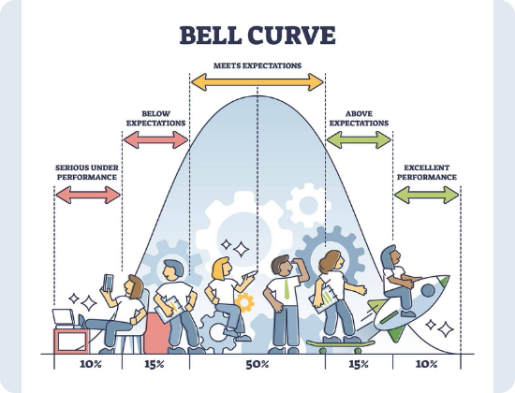
Establishing Reference Norms
A raw score (e.g., "45 correct out of 50") is practically meaningless in isolation.
Norms provide a critical frame of reference by comparing an individual's score to the empirical performance of a defined, representative standardization sample.
Allows for relative, actionable interpretation.
Developed via extensive pre-testing of the target demographic.
Essential for diagnostic, intelligence, and achievement tests.

Slide 11


Common Types of Norms
Percentile Ranks
Standard Scores (Z-Scores)
Indicates the percentage of individuals in the normative group who scored at or below a given raw score.
Expresses a score's exact mathematical distance from the mean in standard deviation units.
This allows for direct, equal-interval comparison across entirely different tests, making it the preferred metric for robust statistical and academic analysis.
If a student scores in the 85th percentile, it simply means they scored better than 85% of the standardization sample. It is highly intuitive for the general public.

Slide 12
Questions & Discussion
Thank you for exploring the criteria of test construction.

Slide 13





Image Sources
https://cambridge-university-press-asses.shorthandstories.com/0f533bdf-80e2-4e7b-ad79-fad195e28ac3/assets/o6f8ni9lDD/ila-image-cropped-1138x636.png
Source: www.cambridge.org
https://png.pngtree.com/png-clipart/20241208/original/pngtree-bullseye-darts-precisely-hit-the-target-png-image_17733035.png
Source: pngtree.com
https://cdn.prod.website-files.com/67008ba73b4fd0346790d085/672952065c55b88279dc54c2_nsplsh_cf0598dc453e4639bfee8dddfa75bcce~mv2.webp
Source: www.theiamarkerless.com
https://png.pngtree.com/png-vector/20251122/ourlarge/pngtree-balance-scale-with-two-equal-weights-png-image_18044224.webp
Source: pngtree.com
https://www.simplypsychology.org/wp-content/uploads/bell-curve.jpg
Source: www.simplypsychology.org

