Slide 1
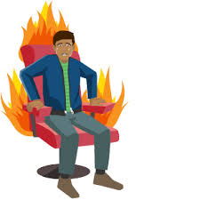
B.Ed. 1st Semester under Gauhati University
HOT SEATING
Prepared & Presented by
Dulal Gogoi
Assistant Professor
Bongaigaon B.Ed. College

Slide 2
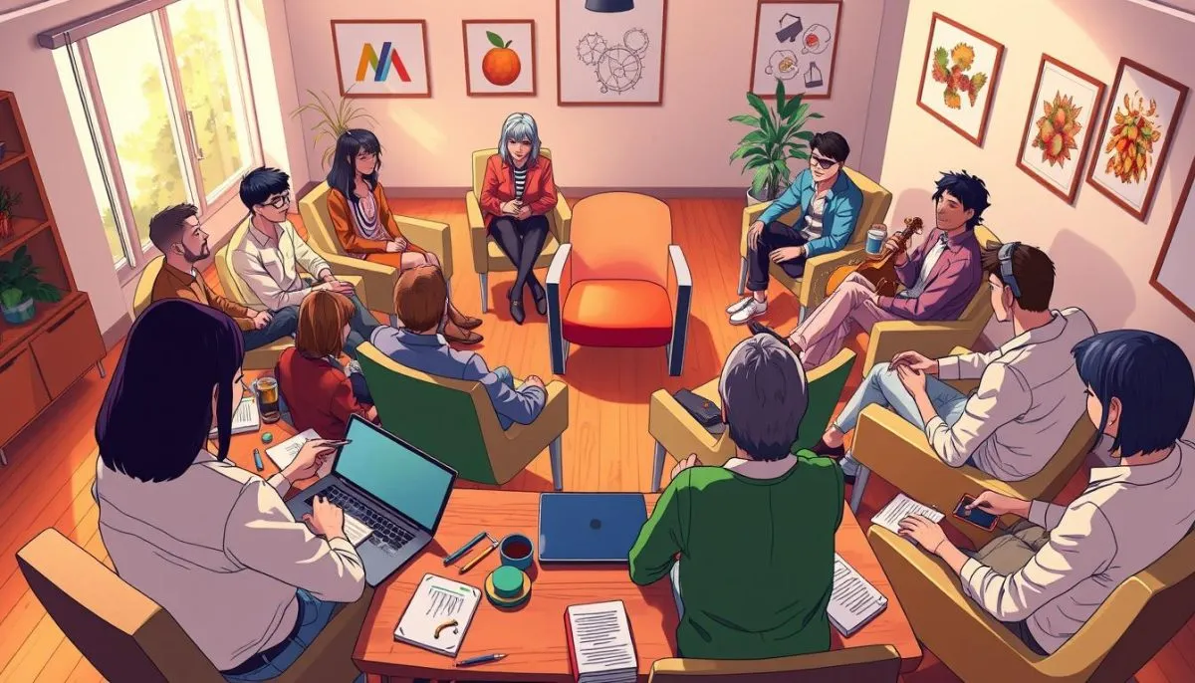
Learning Objectives
Understand the concept of Hot Seating.
Develop questioning and communication skills.
Enhance imagination and character understanding.
Build empathy and reflective thinking.

Slide 3

Teaching Aids
Chairs
Flashcards / Character cards
Whiteboard and markers
Story or textbook lesson

Slide 4

Previous Knowledge
Students already know basic storytelling and character roles.

Slide 5
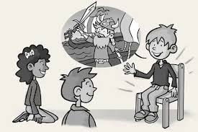
Introduction
Teacher asks: What is a character?
Teacher shows a picture of a known story character.
Brief discussion to connect with the topic.

Slide 6
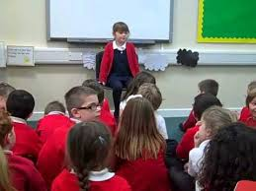
Presentation:
What is Hot Seating?
A drama technique where one student sits as a character.
Others ask questions to explore the character’s thoughts and actions.
Encourages deep discussion and critical thinking.

Slide 7
Procedure
Select a story or chapter.
Choose a student to sit in the Hot Seat.
Give 1-minute character preparation.
Class asks open-ended questions.
Teacher guides deeper responses.

Slide 8
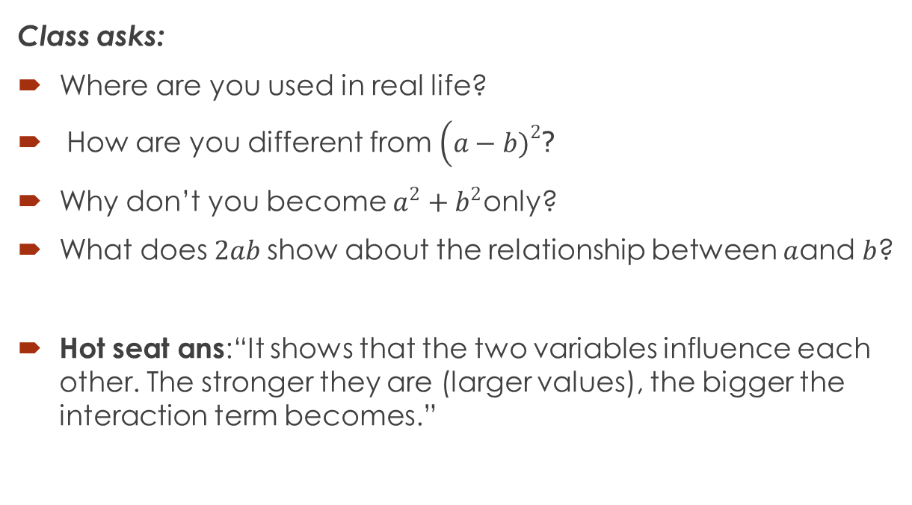

Example Activity
Hot seat as: ${(a+b)}^{2}$=$a^{2}+b^{2}+2ab$
Class asks:
Where are you used in real life?
How are you different from $\left(a−b{\left.)\right.}^{2}\right.$?
Why don’t you become $a^{2}+b^{2}$only?
What does $2ab$show about the relationship between $a$and $b$?
Hot seat ans:“It shows that the two variables influence each other. The stronger they are (larger values), the bigger the interaction term becomes.”

Slide 9

Example 2.0
Hot seat as: Zero (0)
Class asks:
Why are you neither positive nor negative?
Why can’t we divide by you?
Why are you important in place value?
Do you feel lonely?

Slide 10

Assessment
Observation of participation
Quality of questions asked
Reflection statements from students
Understanding of character emotions

Slide 11

Conclusion
Hot Seating helps students think deeply, communicate confidently, and understand characters beyond the text.

Slide 12
Learning Outcomes
Students demonstrate better questioning ability.
Improved verbal communication.
Greater empathy and insight into characters.
Active participation in drama-based learning.

Slide 13
Thank you

