Slide 1

Pragmatism in Education
B.Ed. 1st Semester under Gauhati University
Prepared & Presented by
Bismita Das Sanyal
Assistant Professor
Bongaigaon B.Ed. College

Slide 2

Concept of Pragmatism
The word pragmatism has been derived from Greek word ‘Pragma’ which means ‘Activity’.
Pragmatism is that school of Western Philosophy which considers the universe as the outcome of different elements and activities.
It accepts the physical world as the only real world.
It does not consider God.
It propounds that the ultimate aim of human life is to live happily which can be achieved by following social laws.

Slide 3
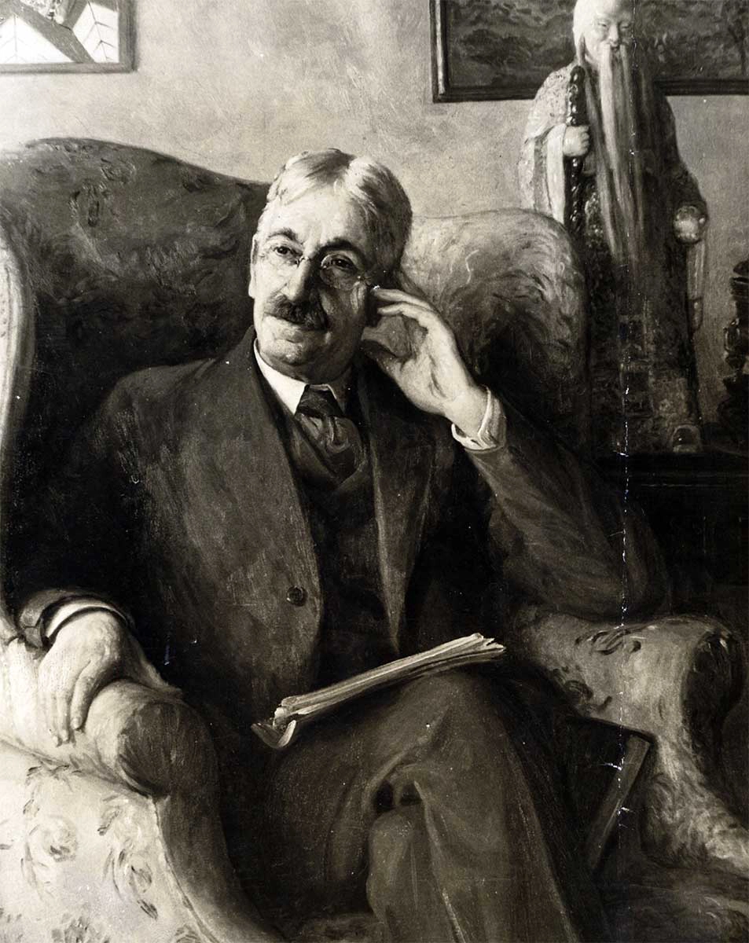
Thinkers
Charles Senders Pierce
William James
John Dewey
Kilpatrick

Slide 4
In Education
According to pragmatists education is the process of development of man which takes place in the social environment.
By it the culture of the society is preserved , communicated and developed.
Pragmatism believes in utility therefore education which has practical utility in the individual’s life should only be imparted to the child.
Education in Pragmatism is child centered .
Pragmatism believes in learning by doing.
Education according to Pragmatism philosophy must be life related.

Slide 5

Aim of Education
Growth and development
Development of ability for effective and better living
Utilization of the capacities to the fullest extent
Social efficiency of the individual
Creation of values
Forging better state of society

Slide 6

Curriculum
Principle of utility
Principle of interest
Principle of occupation and activities
Principle of integration

Slide 7

Teaching method
Learning by doing
Project method

Slide 8
THANK YOU

